Slide 1
AI-Powered Sleep Quality Predictor & Coach
An innovative, accessible, and actionable sleep health platform using only smartphone sensors — no wearables required.
Presented by: Shahzaib Khan
Team Zeta

Slide 2
The Problem: Barriers to Better Sleep Insights
High Barrier to Entry
Most sleep tracking tools require expensive or uncomfortable wearable devices, limiting accessibility for many users.
The 'Data Overload' Problem
Users get plenty of graphs and scores, but lack clear, actionable advice on how to improve their sleep quality.
The Insight Gap
There's a disconnect between raw sleep data and practical, personalized improvements that users can implement.

Slide 3
Project Objectives
Smart & Accessible
Deliver an easy-to-use, hardware-free sleep monitoring solution that works with the smartphone you already own — no expensive wearables required.
Intelligent Prediction
Accurately predict sleep quality using only smartphone-inferred data, including movement patterns, phone usage, and environmental factors.
Actionable AI Coaching
Provide personalized, clear, and actionable advice through AI coaching tailored to each individual's unique sleep patterns and lifestyle.

Slide 4
Datasets: Smartphone Sensors + SleepQual
Smartphone Sensor Data
Accelerometer, phone lock/unlock events, ambient light, and device usage patterns during nighttime hours provide a non-invasive way to detect sleep patterns.
SleepQual & B.Health Datasets
Labeled datasets with sleep quality classifications (good/poor sleep) and associated user lifestyle factors that provide essential training data for our machine learning model.
Key Advantage
By combining these datasets, we've created a wearable-free approach to sleep monitoring that's accessible to anyone with a smartphone, without requiring additional hardware.

Slide 5



Feature Engineering: What Do We Measure?
Input Features ("Causes")
Duration in Bed Time to Fall Asleep
Awakenings During Night Nighttime Phone Usage Phone Unlock Count
Output ("Effect")
Good Sleep
or
Not Good Sleep
Prediction Confidence Score
94% Model Accuracy

Slide 6
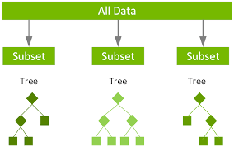


XGBoost ML Model: Fast, Accurate, Reliable
94%
Accuracy
Why XGBoost for Sleep Prediction?
High Performance
Industry standard for tabular data with superior predictive power.
Robust & Reliable
Handles complex relationships and prevents overfitting through regularization.
Processing Speed
Enables fast training and real-time predictions for responsive user experience.

Slide 7

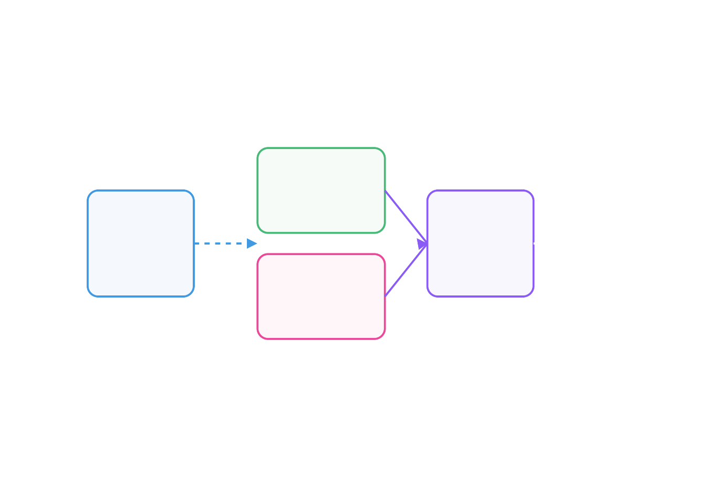
Dual-Intelligence System Architecture
AI Synergy System
The Two "Brains" Working Together
The Diagnostician (XGBoost)
Provides fast, accurate, and objective prediction of sleep quality based on smartphone behavioral patterns.
XGBoost
The Diagnostician
The Expert Coach (Gemini AI) Synthesizes predictions with lifestyle factors to provide personalized, actionable advice.
Smartphone Sensor Data
Integration Layer
UI
Gemini AI
The Expert Coach
Integrated Experience
Delivers both objective data analysis AND human-like coaching in a single, seamless interface.

Slide 8
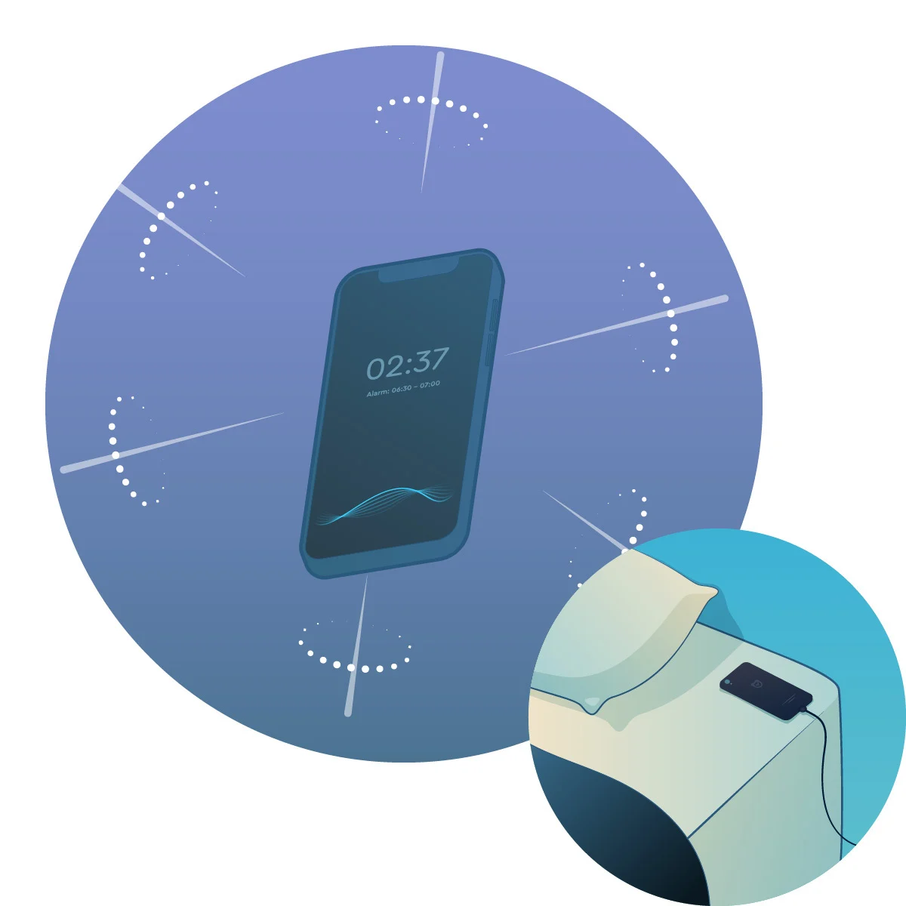
Solution Demo: Interactive Dashboard
No Wearable Needed
Dashboard Key Features
Sleep Quality Trends
Visualize your sleep patterns over time with intuitive graphs and metrics.
Actionable Insights
Clear, highlighted recommendations based on your sleep data analysis.
Phone-Only Tracking
Monitor sleep patterns using just your smartphone — no wearable device required.

Slide 9
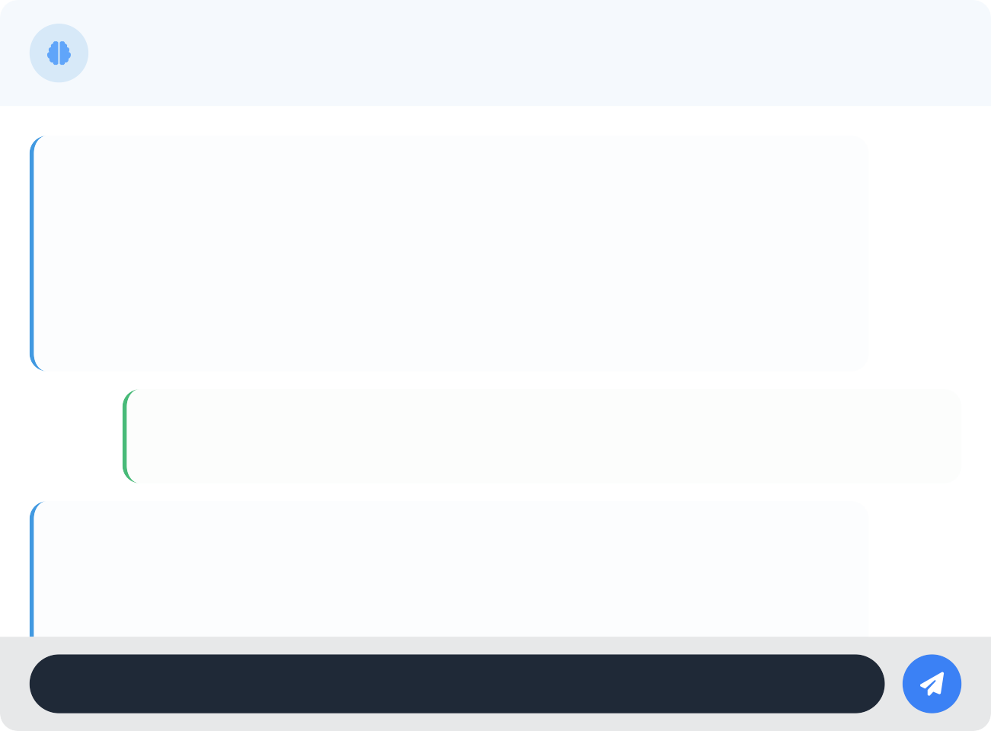
Solution Demo: Personalized AI Coaching
Sleep Coach
Powered by Google Gemini AI
Good morning, Sarah. I noticed your sleep quality was poor last night (65%). Would you like to understand why and get some personalized recommendations?
Yes, please. I felt tired when I woke up.
Analysis: Based on your data, you spent 40 minutes on your phone right before bed, took 35 minutes to
Ask your sleep coach...
Personalized AI Coaching Benefits
Contextual Understanding
Analyzes sleep patterns alongside lifestyle factors like caffeine intake, exercise, and stress levels.
Conversational Interface
Natural dialogue allows users to ask questions and get personalized advice in human-like language.
Actionable Insights
Provides specific, practical recommendations tailored to your unique sleep patterns and lifestyle.
Made with Genspark

Slide 10
Thank You
Questions & Answers
Ready to bring actionable, AI-powered sleep insights to everyone, no wearables required.
Presented by: Shahzaib Khan
Team Zeta

